Slide 1
comparison of anthropogenic emissions among AeroCom-II inventories
Xiaohua Pan, Mian Chin, Thomas Diehl and Angelika Heil

Slide 2
AeroCom emissions
 | AeroCom – II ACCMIP | ACCMIP | AeroCom –II HCA0 v1/v2 | AeroCom - I
contact | A Heil a.heil @fz-juelich.de | JF Lamarque lamar @ncar.ucar.edu | T Diehl thomas.diehl @nasa.gov | F Dentener frank.dentener@ jrc.ec.europa.eu
temporal resolution | 1850,1980-2010 yearly monthly | 1850-2100 decadal monthly | 1980-2006 yearly | 1750, 2000 yearly monthly
spatial resolution | 0.5ºx0.5º | 0.5ºx0.5º | 1ºx1º | 1ºx1º
unit | kg/m2/s | kg/m2/s | kg/grid/yr | kg/grid/yr
species | BC, OC, SO₂, CO, CH₄, NH₃, NO_{x} | BC, OC, SO₂, CO, CH₄, NH₃, NO_{x}, VOC | BC, OC, SO₂ updated SO₂ | BC, OC, SO₂, DU, SS, SOA
sectors | 8 anthr, ship, air 2 bb (GFED-2 and RETRO) | 8 anthr, ship, air 2 bb (GFED-2) | 8 anthrop 2 bb (GFED-2) | 8 anthrop 2 bb (GFED-1)

Slide 3
must know … about AeroCom-II ACCMIP
annual AeroCom-II ACCMIP emission (i.e. 1850, 1980 to 2000) were calculated from linear time interpolation of AEROCOM-II IPCC-AR5 decadal data
inter-annual monthly biomass until 2008
use of rcp8.5 scenario for 2000-2100 period
addressed are: anthropogenic and biomass burning emissions of seven selected species
  BC, OC, CO, CH4, NH3, SO2, NOx
aircraft emissions are stored in separate (annual) files … because of their 3D nature

Slide 4
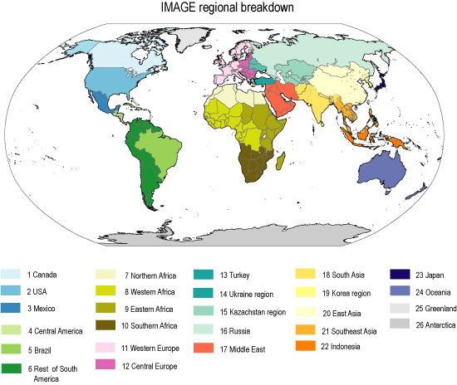
ancillary data … of AeroCom-II ACCMIP
grid area
  the grid area for each 0.5deg horizontal grid cell
    (in m² assuming an earth radius of 6371000 meters)
region mask
  based on
  IMAGE 24

Slide 5
must know … AeroCom –II HCA0 v1/v2
yearly emission (1980 to 2006)
sub-micron aerosol
  fossil fuel
    BC (spew,1996), OC (spew,1996), SO₂ (edgar,2000)
    time-evolution by D.Streets
  wild-land fires
    BC, OC, SO₂ (GFED-2, before 1997 AVHRR-scaling)
  aircraft … by Boeing (61 altitudes)
  ship … by Eyring
volcanic aerosol
  explosive … viaTOMS satellite data
  continuous … from GEIA inventory

Slide 6
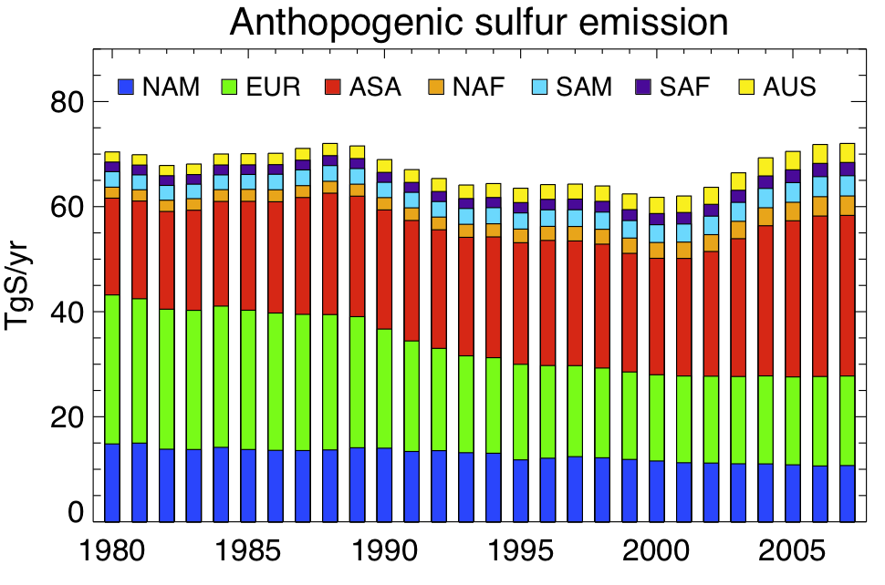
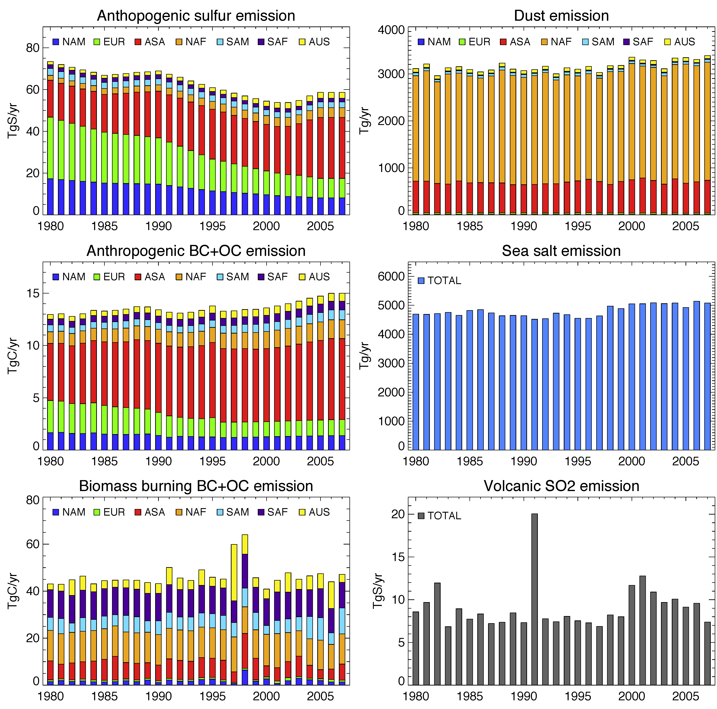
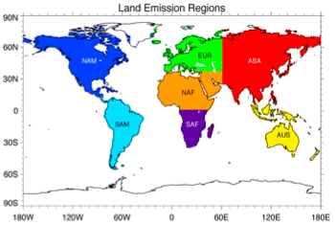
HCA0 v1 vs HDA0 v2
new v2 has diff. SO₂
edgar 2000 → edgar 4.1
- less SO₂ over Europe
- more SO₂ over N.Africa

Slide 7
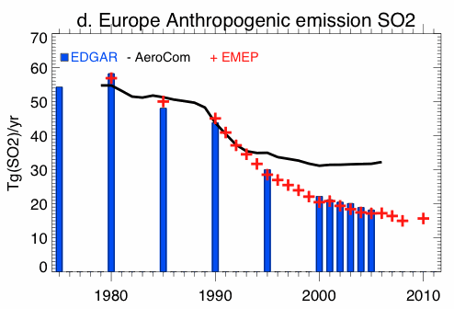
anthrop. SO₂ emissions over EU
ver.1
ver.2

Slide 8
AeroCom – II HCA0 v2

Slide 9
comparisons
ACCMIP
“IPCC: ACCMIP-hist. / rcp 8.5”
AeroCom-II ACCMIP
“MACCity: ACCMIP MACCity”
AeroCom-II HCA0 v1/v2
“AeroComHC: AeroCom-HC”

Slide 10
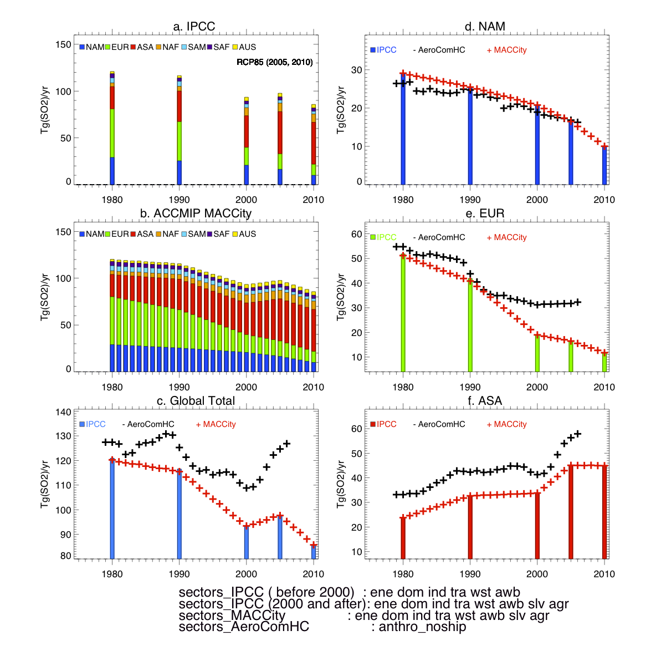
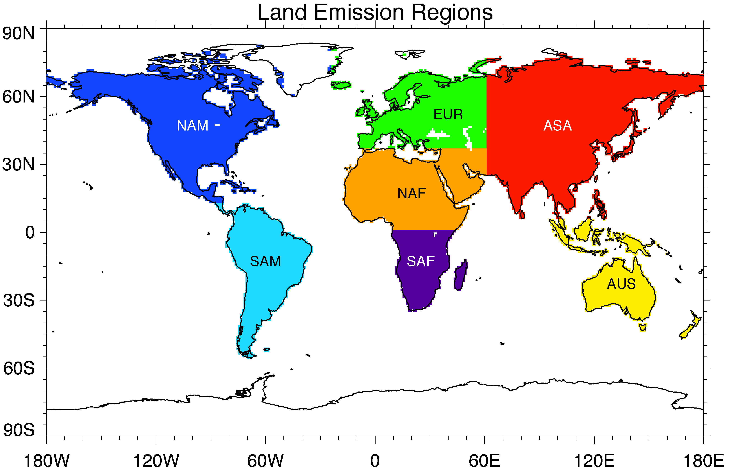
anthropogenic emission - SO₂
ACCMIP
IPCC: ACCMIP-hist. / rcp 8.5
AeroCom-II ACCMIP
MACCity: ACCMIP MACCity
AeroCom-II HCA0 v1/v2
AeroComHC: AeroCom-HC
ACCMIP
AeroCom-II ACCMIP
regional choices
by Mian Chin

Slide 11
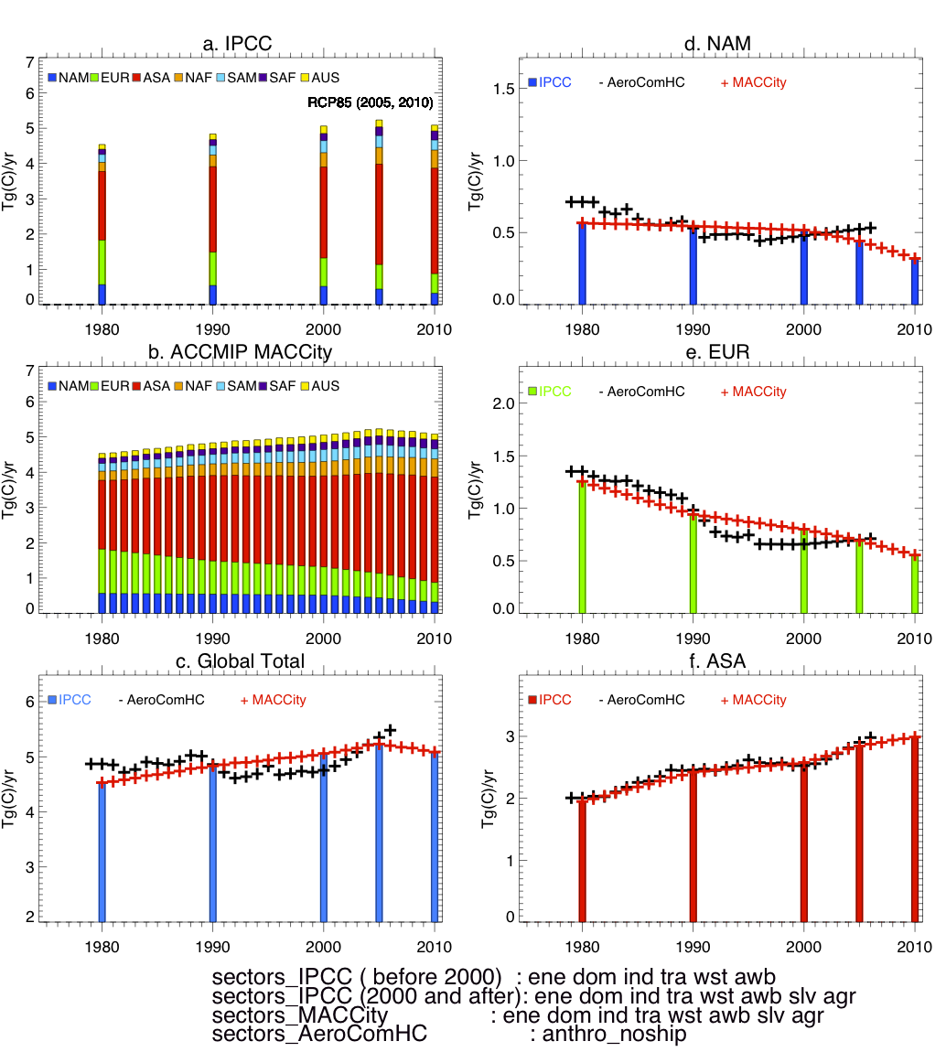
anthropogenic emission - BC
ACCMIP
IPCC: ACCMIP-hist. / rcp 8.5
AeroCom-II ACCMIP
MACCity: ACCMIP MACCity
AeroCom-II HCA0 v1/v2
AeroComHC: AeroCom-HC
ACCMIP
AeroCom-II ACCMIP
regional choices
by Mian Chin

Slide 12
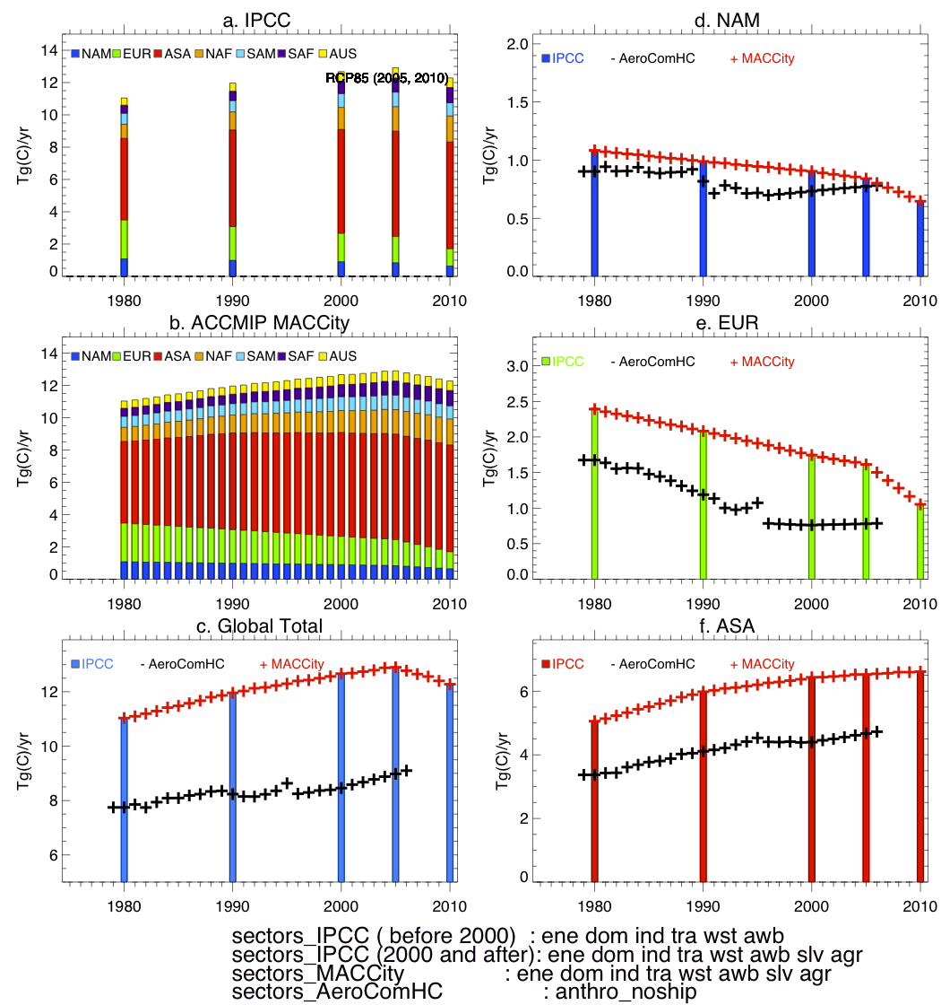
anthropogenic emission - OC
ACCMIP
IPCC: ACCMIP-hist. / rcp 8.5
AeroCom-II ACCMIP
MACCity: ACCMIP MACCity
AeroCom-II HCA0 v1/v2
AeroComHC: AeroCom-HC
ACCMIP
AeroCom-II ACCMIP
regional choices
by Mian Chin

Slide 13
anthrop. SO₂, BC and OC … by sector
AeroCom-II ACCMIP vs ACCMIP
species
  SO2, BC and OC
years
  1980, 1990, 2000 and 2010
sectors
  ene, ind, tra, dom, slv, agr, awb, wst
  shp (ship)

Slide 14
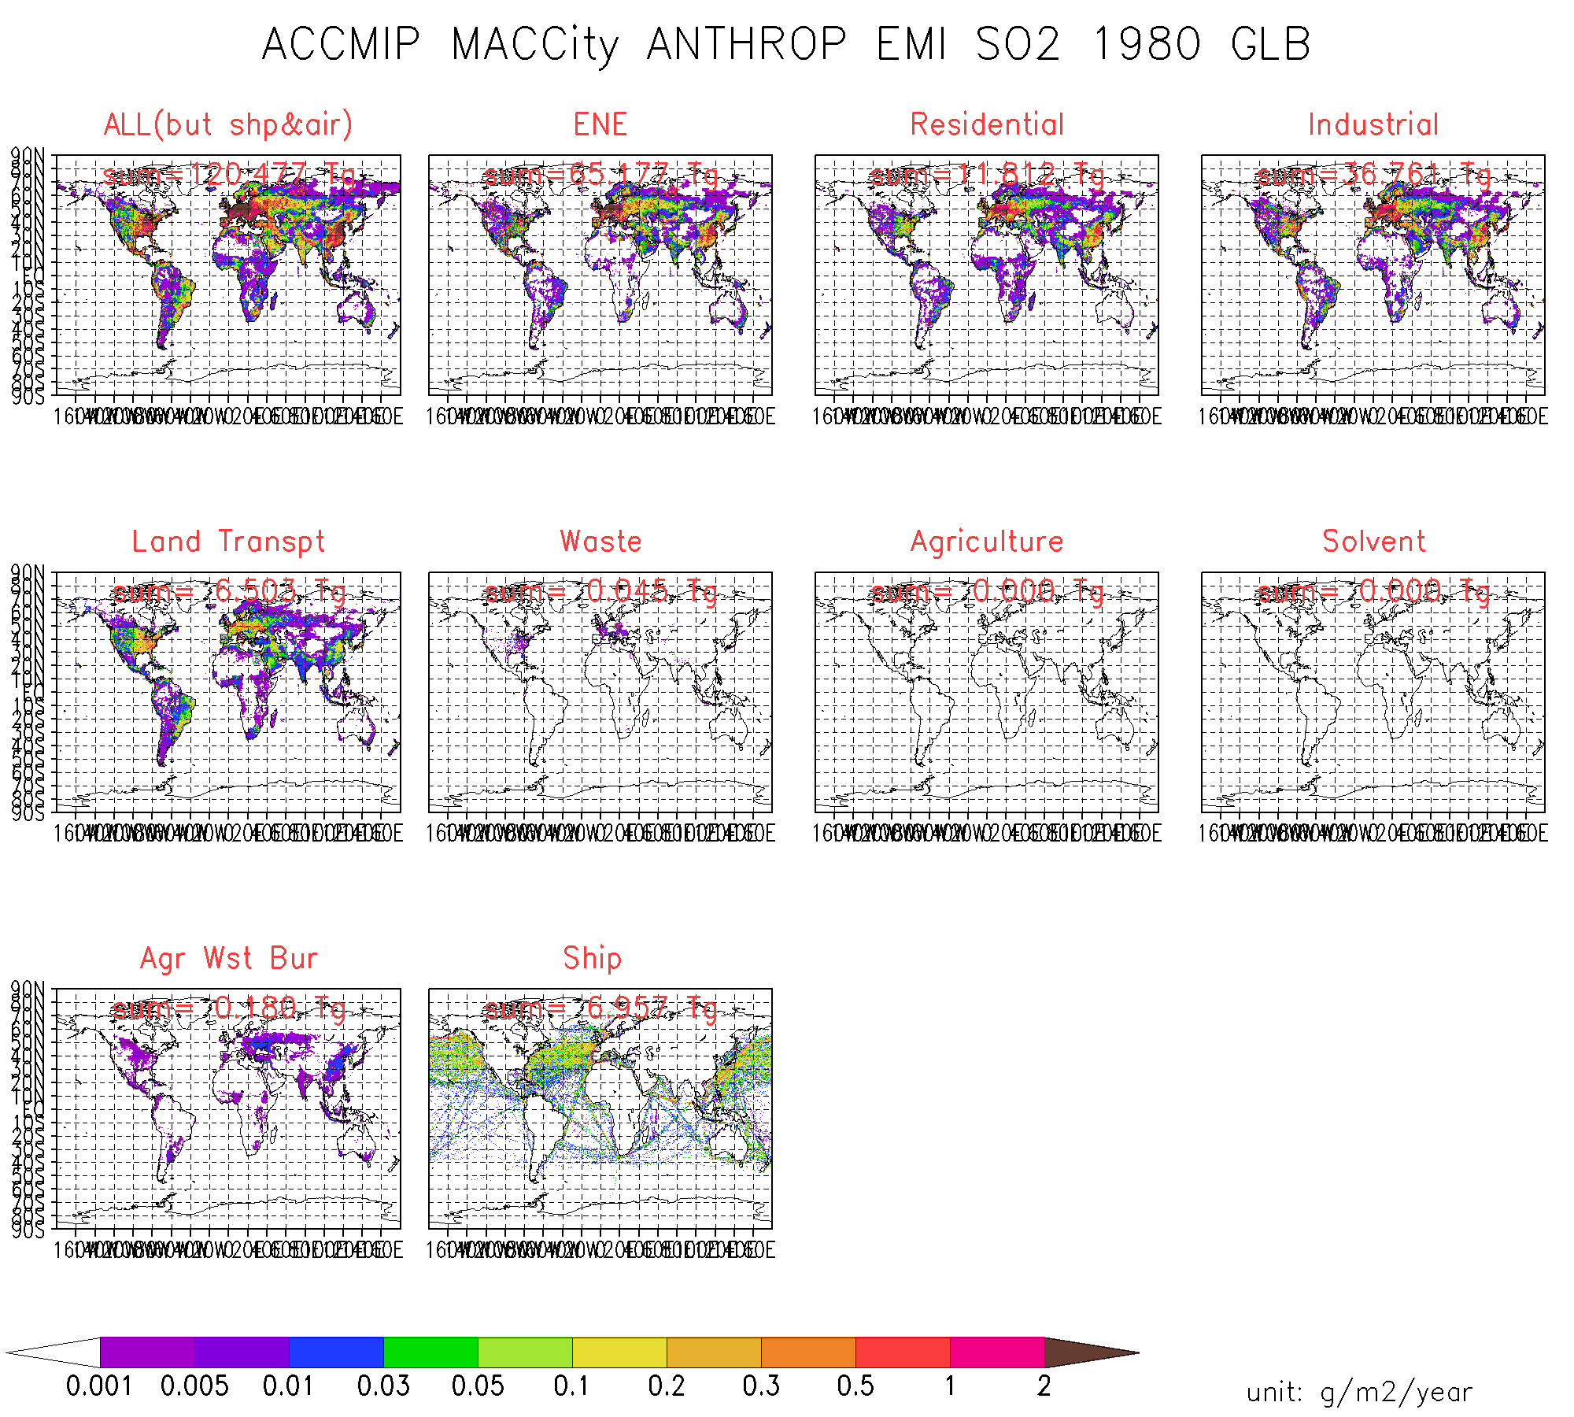
AeroCom-II ACCMIP
SO2… by sector
1980

Slide 15
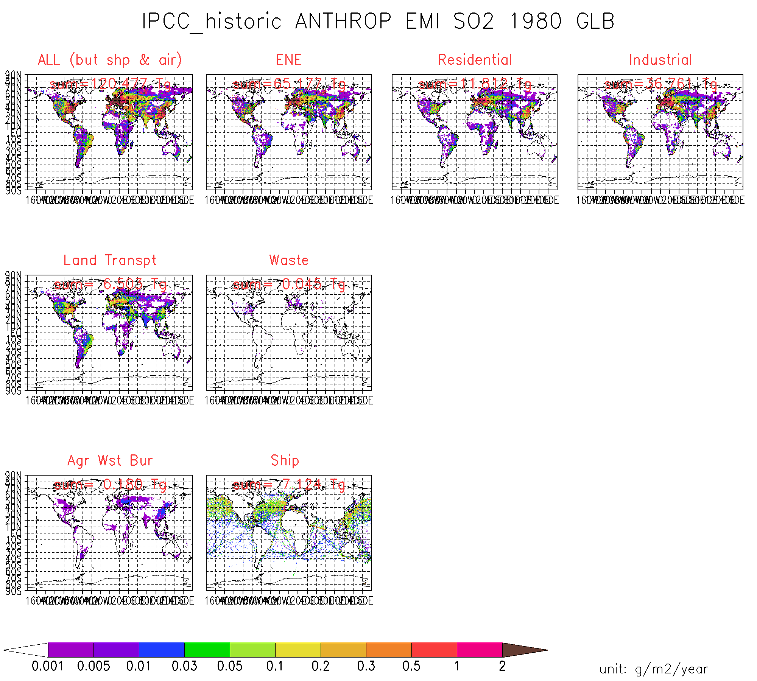
ACCMIP
SO2 … by sector
1980

Slide 16
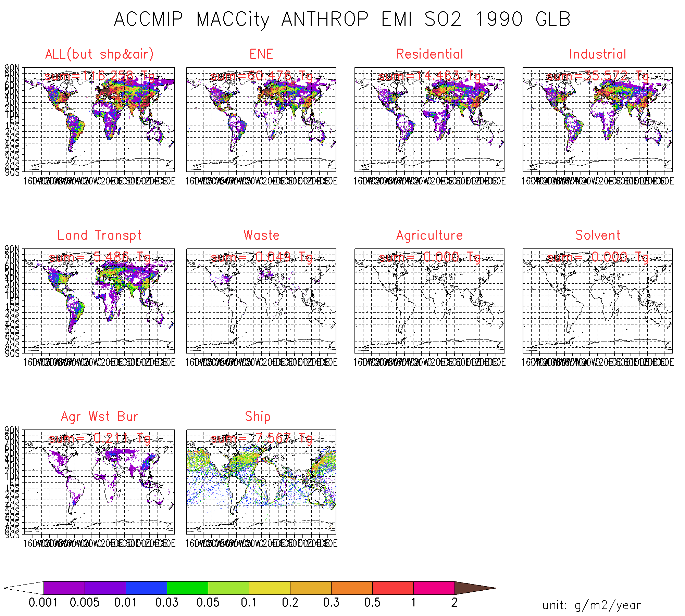
In MACCity:
slv=agr=0
AeroCom-II ACCMIP
SO2 … by sector
1990

Slide 17

ACCMIP
SO2 … by sector
1990

Slide 18
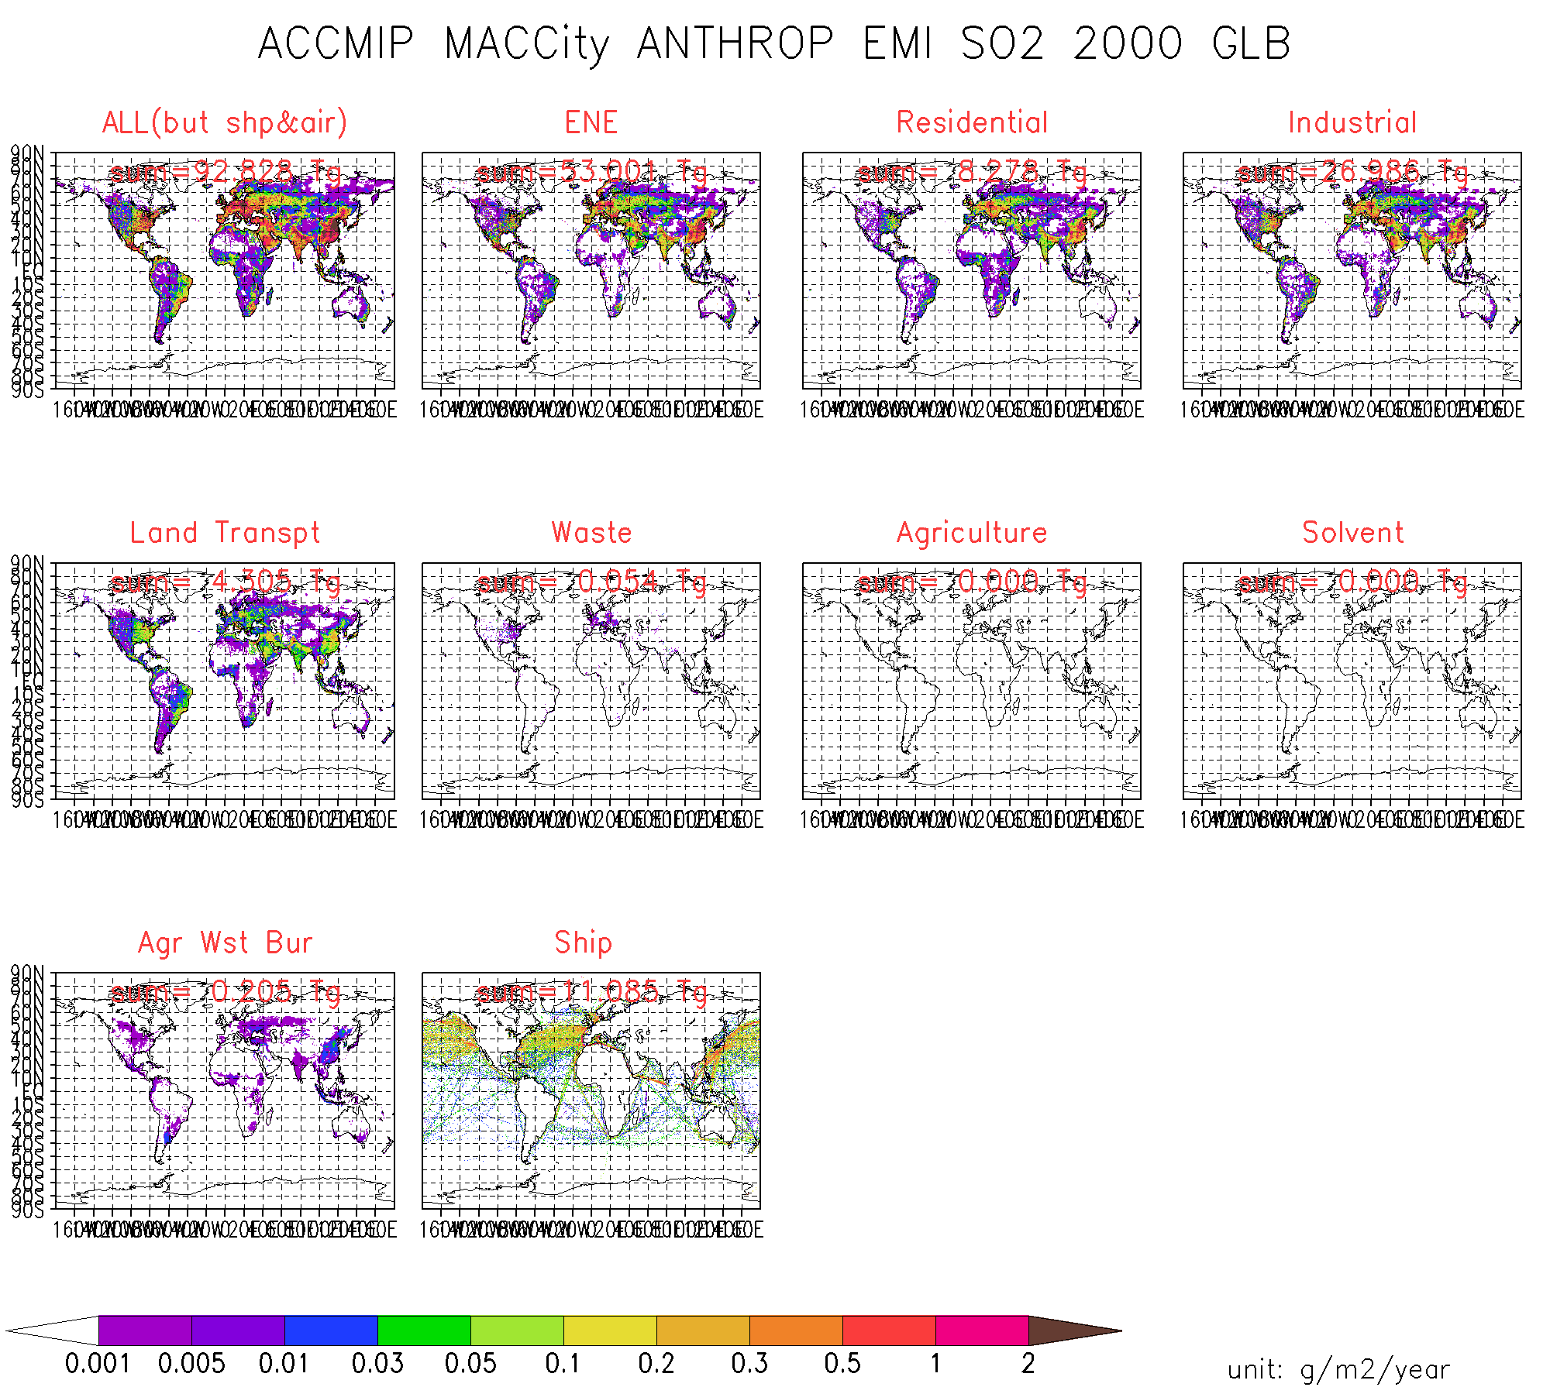
AeroCom-II ACCMIP
SO2 … by sector
2000

Slide 19
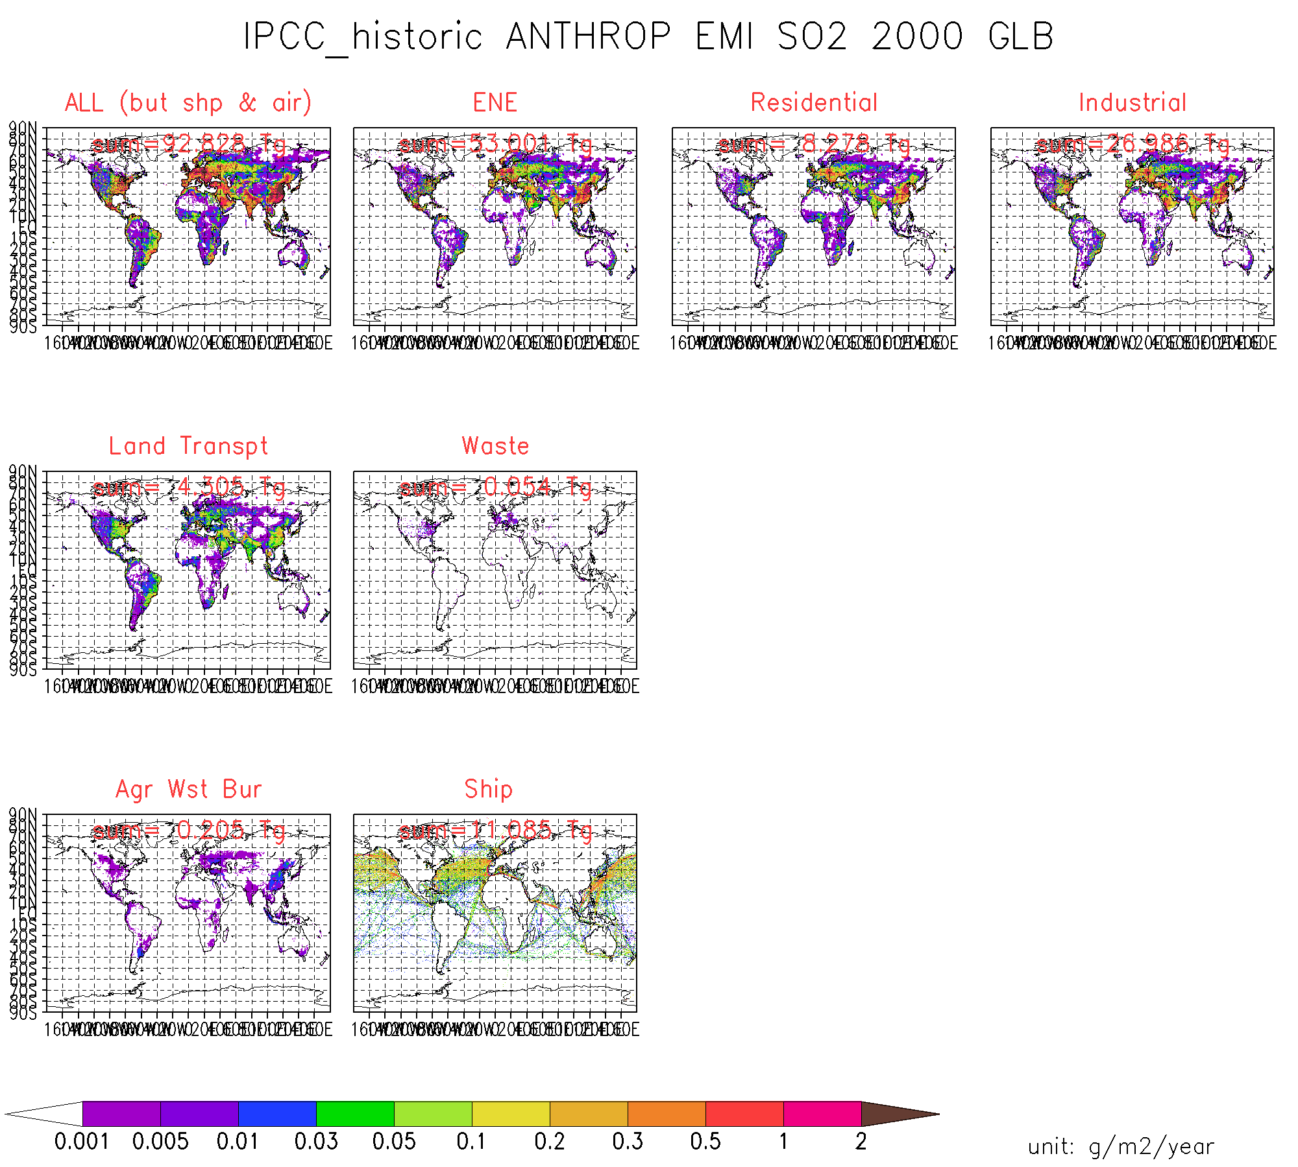
ACCMIP
SO2 … by sector
2000

Slide 20
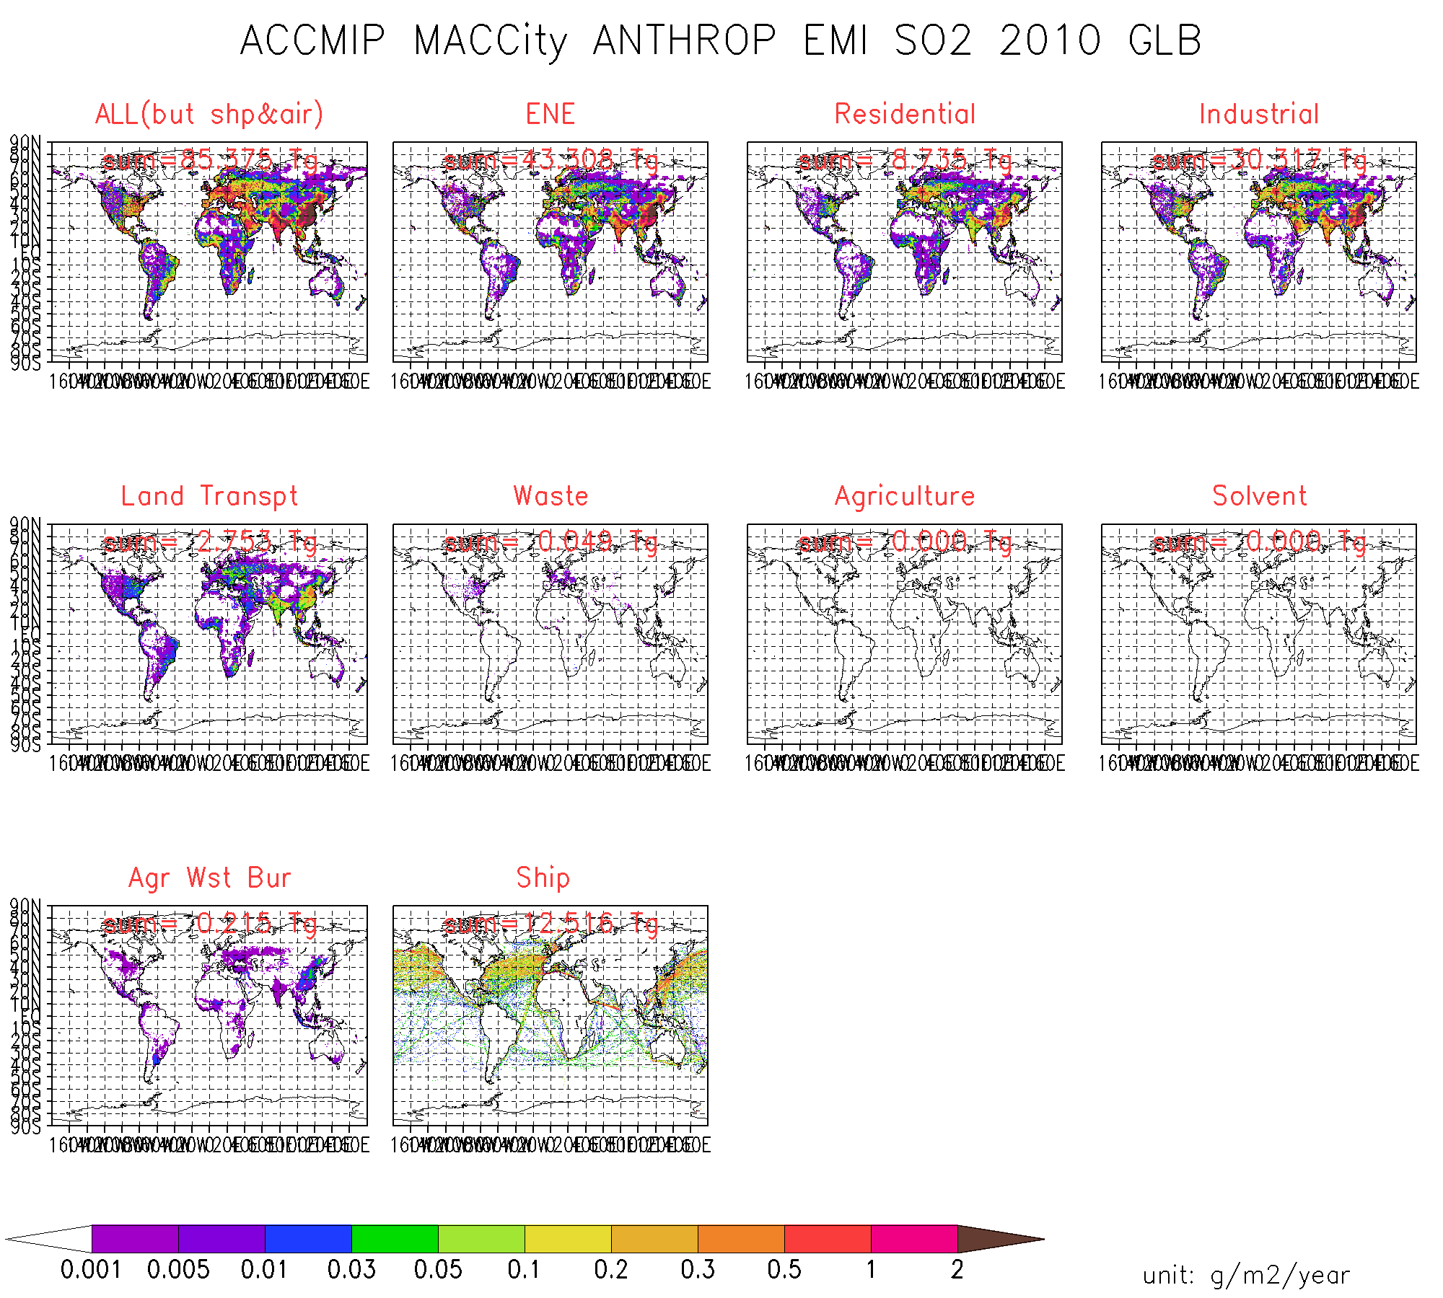
AeroCom-II ACCMIP
SO2 … by sector
2010

Slide 21
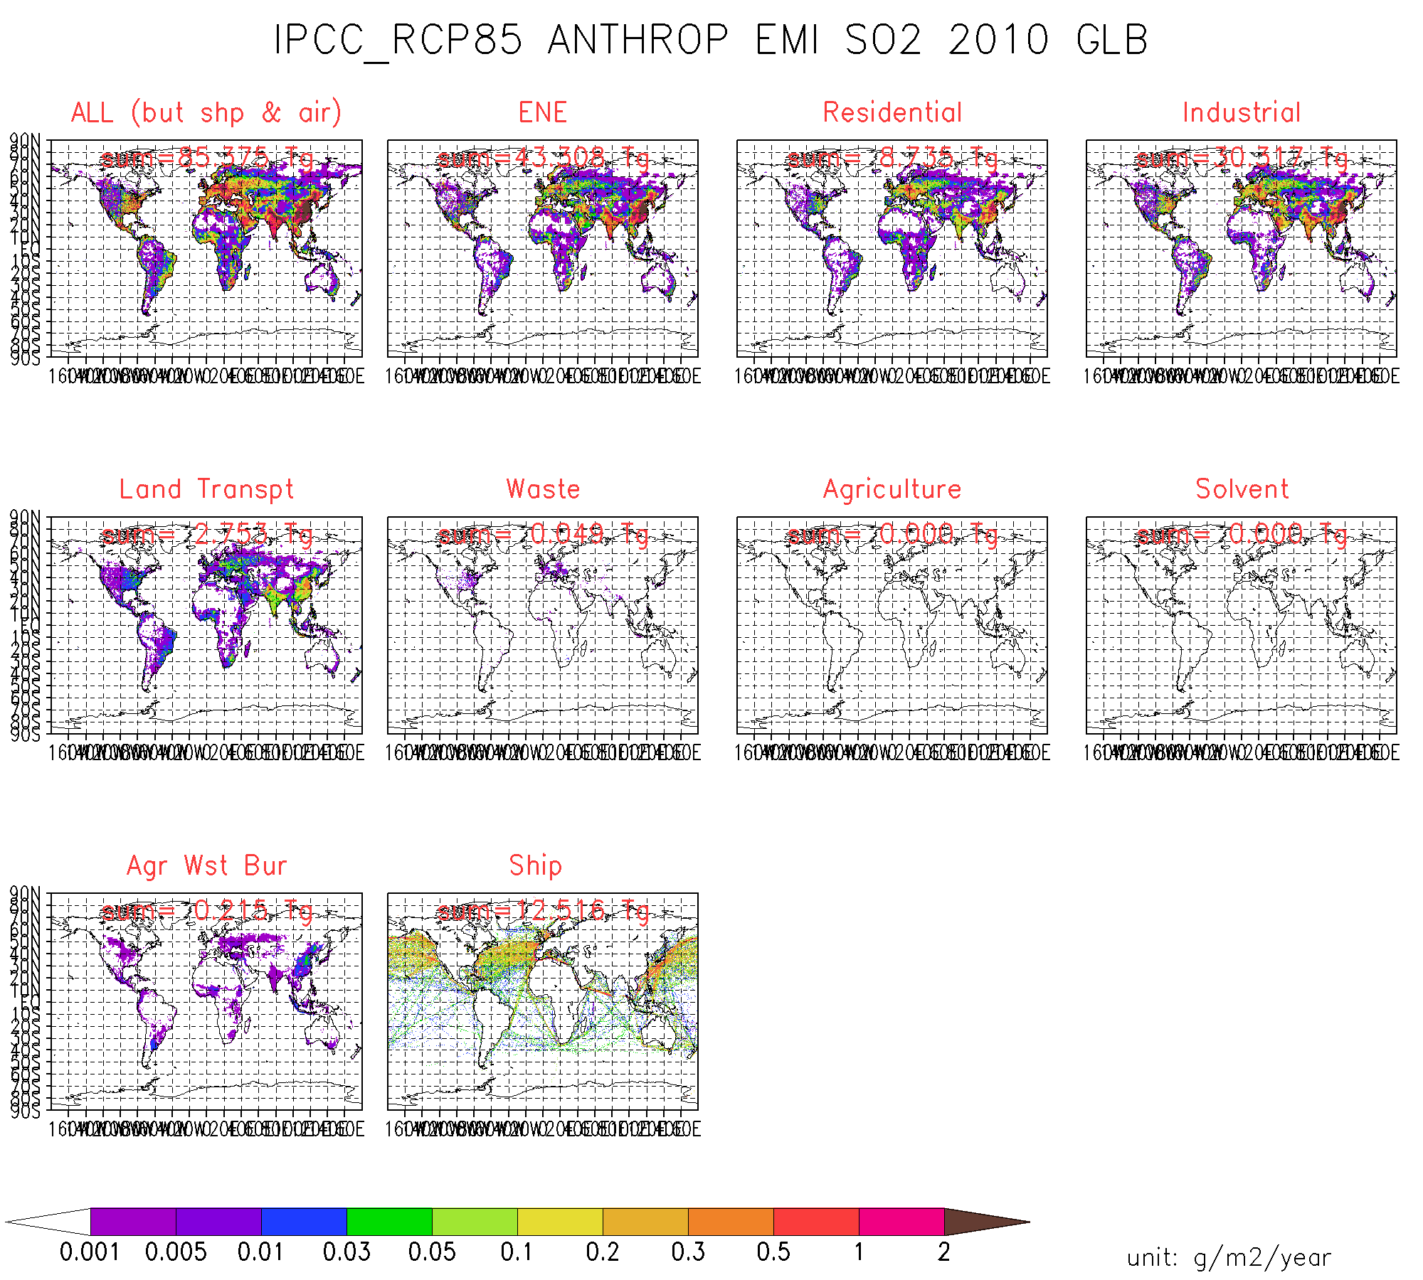
ACCMIP
SO2 … by sector
2010

Slide 22
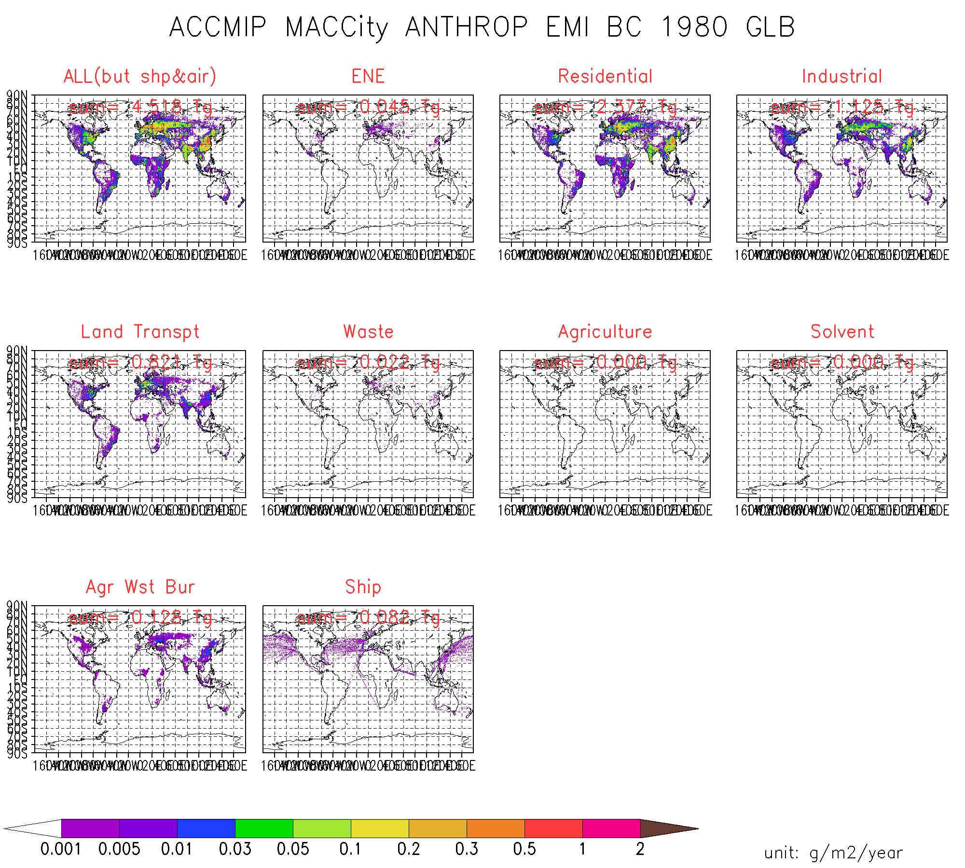
AeroCom-II ACCMIP
BC … by sector
1980

Slide 23
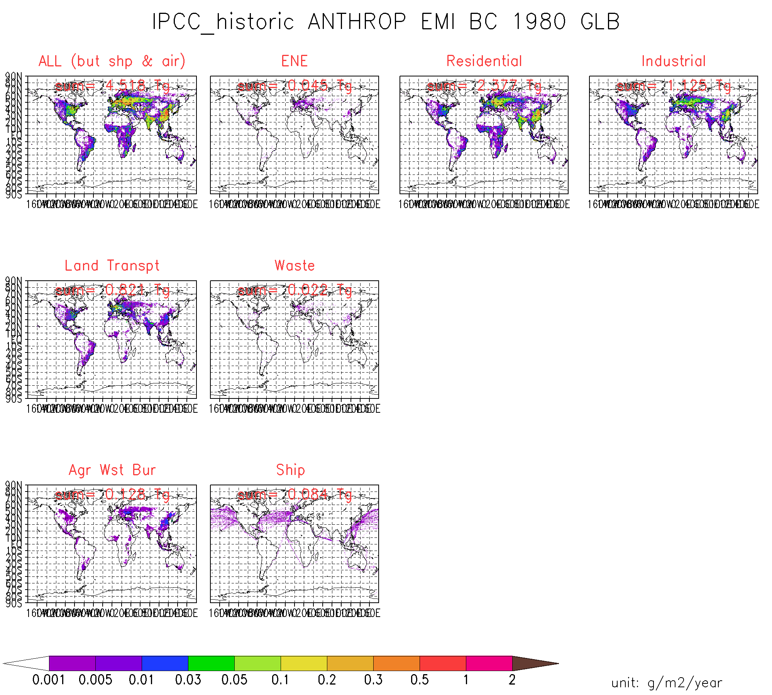
ACCMIP
BC … by sector
1980

Slide 24
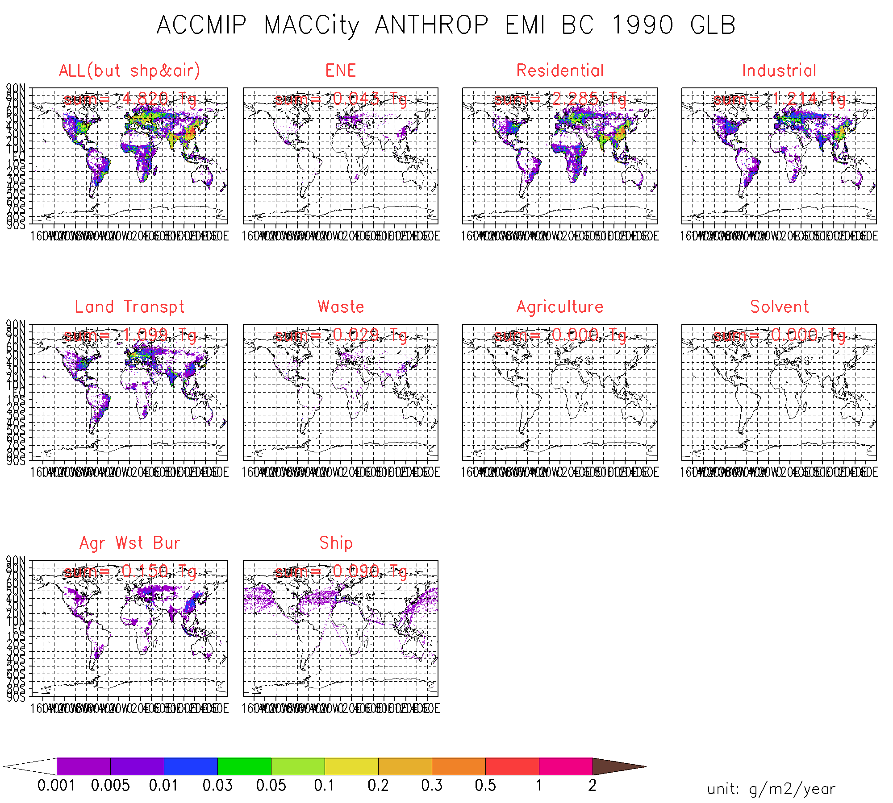
AeroCom-II ACCMIP
BC … by sector
1990

Slide 25

ACCMIP
BC … by sector
1990

Slide 26
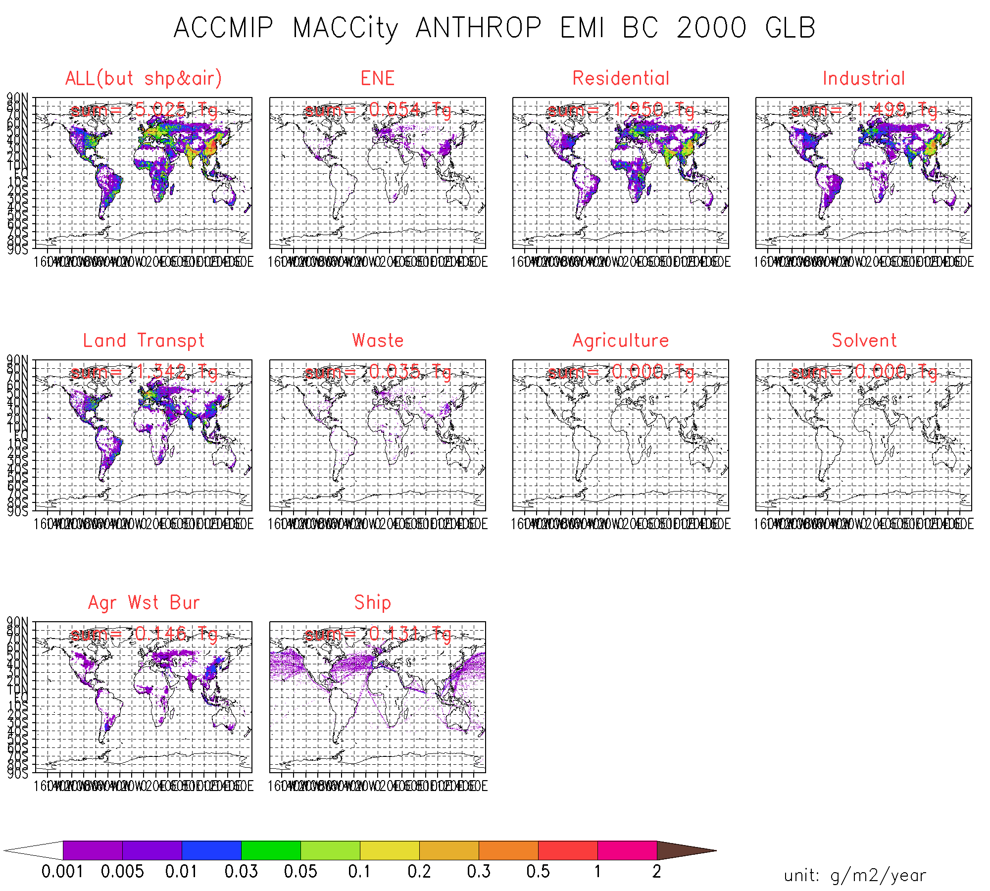
AeroCom-II ACCMIP
BC … by sector
2000

Slide 27

ACCMIP
BC … by sector
200

Slide 28

AeroCom-II ACCMIP
BC … by sector
2010

Slide 29
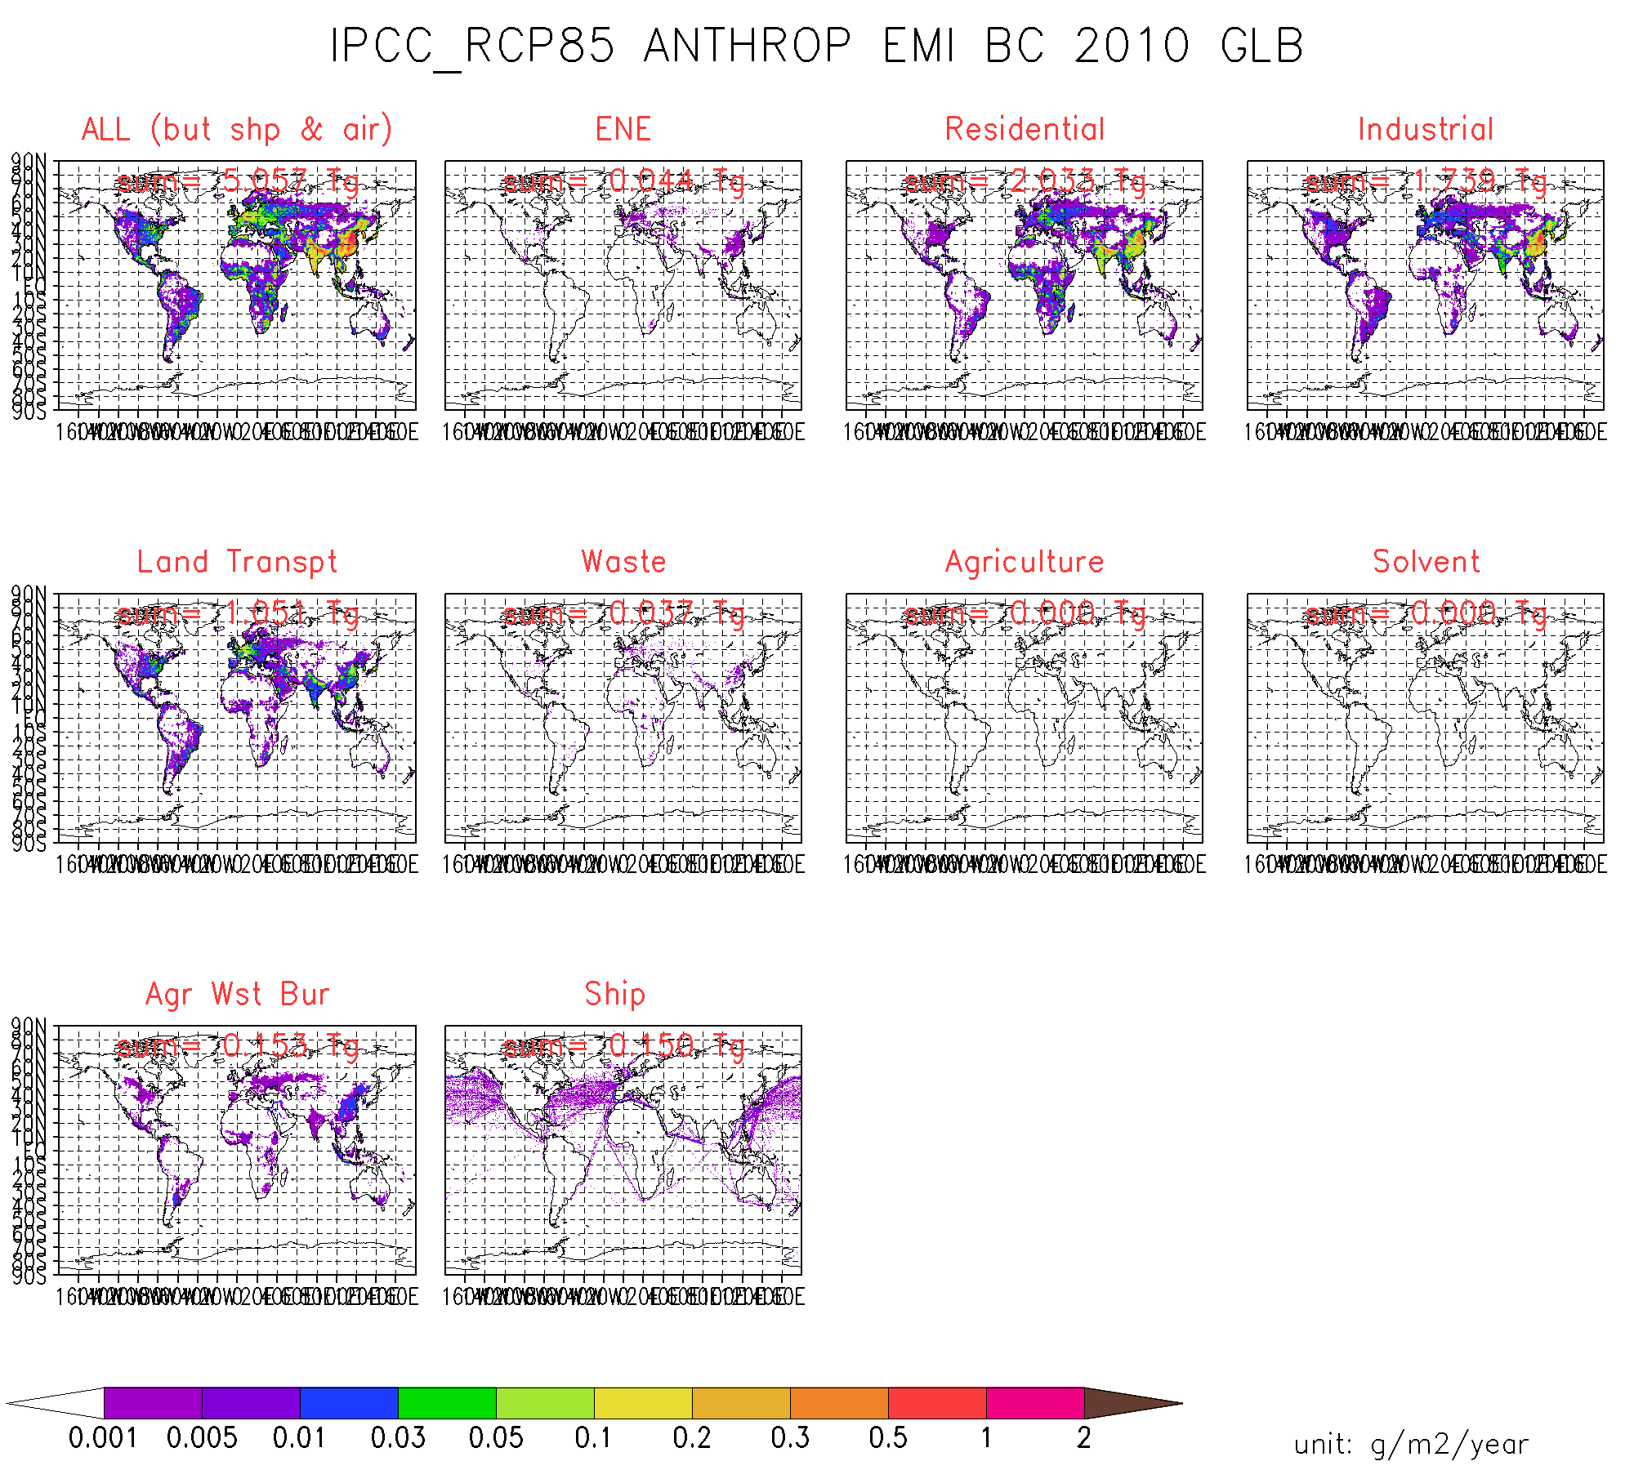
ACCMIP
BC … by sector
2010

Slide 30
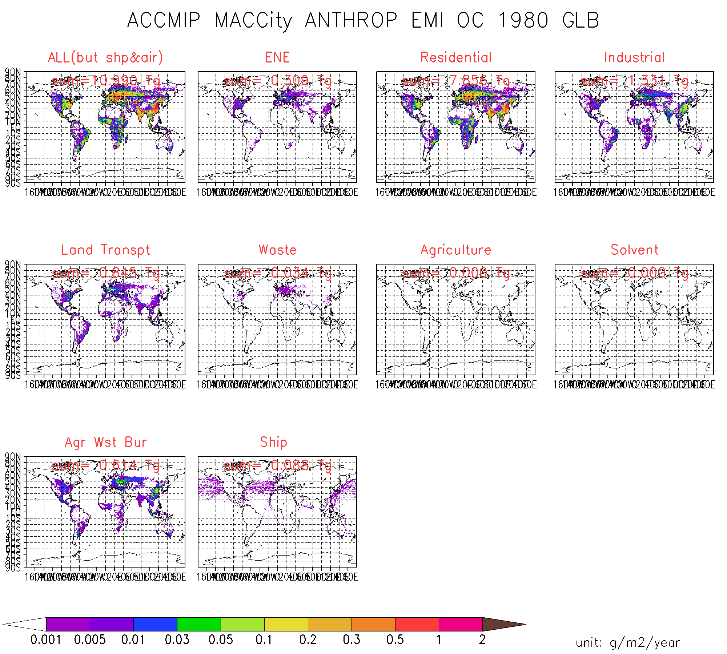
AeroCom-II ACCMIP
OC … by sector
1980

Slide 31
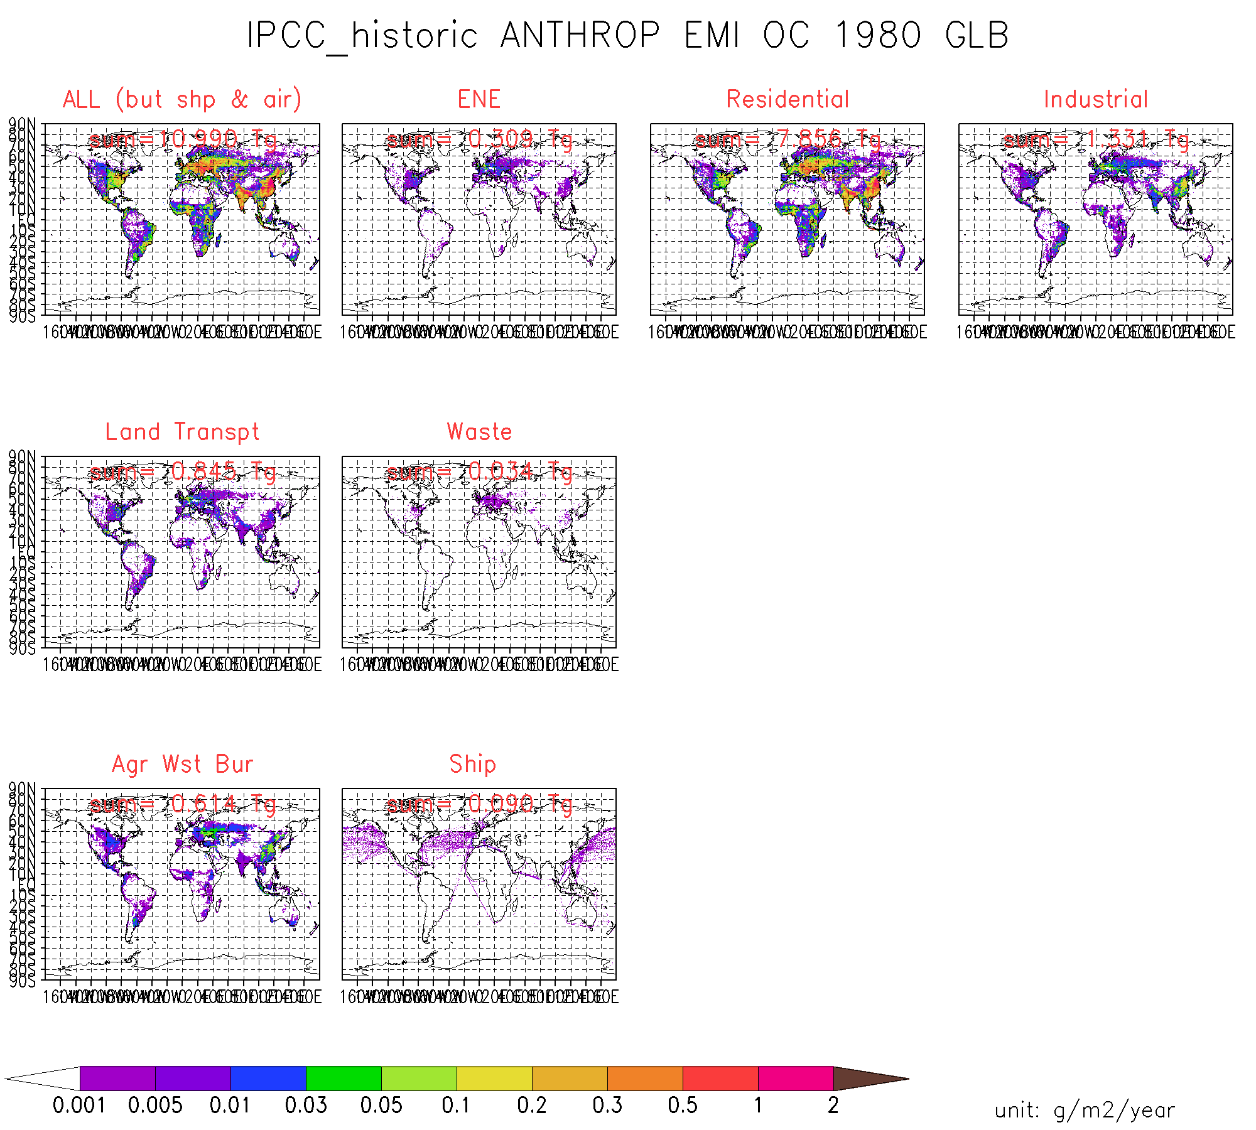
ACCMIP
OC … by sector
1980

Slide 32

AeroCom-II ACCMIP
OC … by sector
1990

Slide 33

ACCMIP
OC … by sector
1990

Slide 34

AeroCom-II ACCMIP
OC … by sector
2000

Slide 35

ACCMIP
OC … by sector
2000

Slide 36
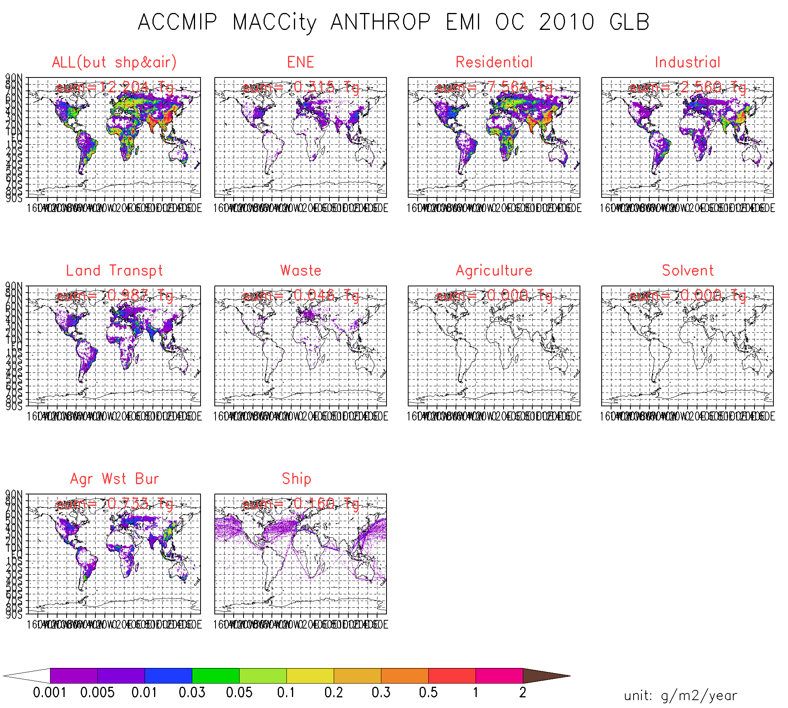
AeroCom-II ACCMIP
OC … by sector
2010

Slide 37
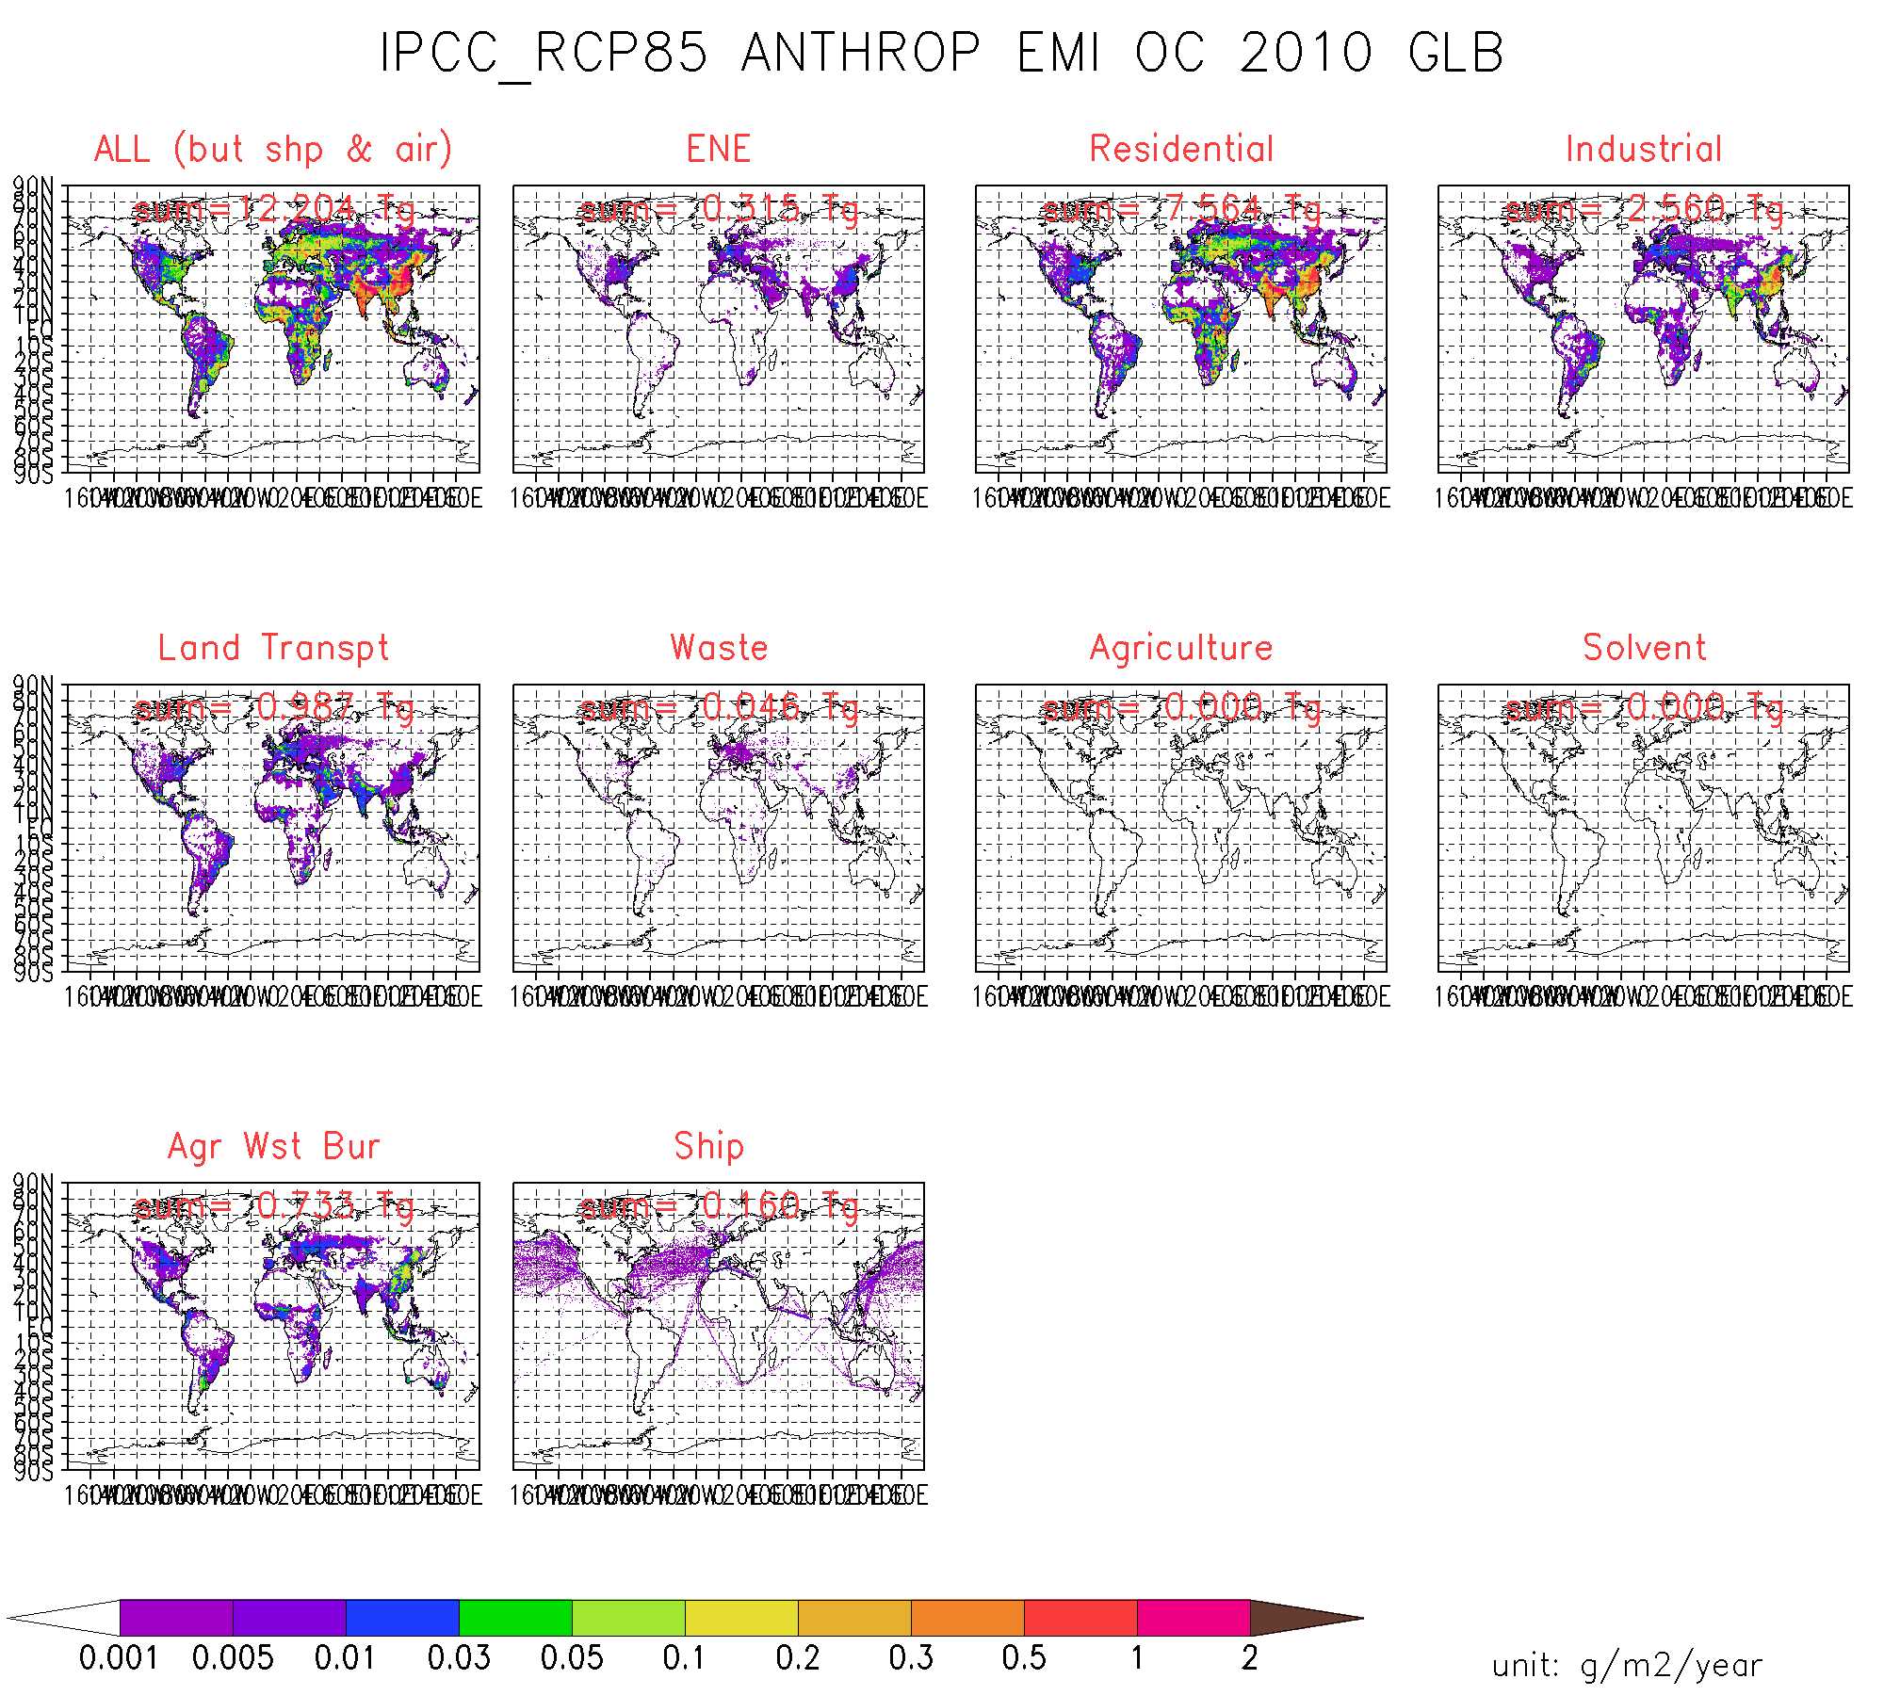
ACCMIP
OC … by sector
2010

Slide 38
conclusions (1)
AeroCom-II ACCMIP vs. ACCMIP
annual means are identical
  except for ship-emissions (2-6% smaller for only 1980 and 1990 in AeroCom (-II ACCMIP) due to the linear time interpolation procedure taking into account the *true* original timestamps)
  except for biomass burning emissions
AeroCom biomass burning has strong inter-annual variations (1980 to 2006) - ACCMIP not
AeroCom is CF compliant - ACCMIP not

Slide 39
conclusions (2)
AeroCom-II ACCMIP vs AeroCom-II HCA0 v1
        old SO₂ data
  AeroCom ACCMIP has lower anthro. SO2 emissions
    Europe after 1990 (~ half less) & Asia (~ 30% less)
  AeroCom ACCMIP has higher anthro. OC emissions
    Europe after 1990 (~ double) & Asia (~ 50% more)
  anthrop. BC emissions are comparable

